Slide 1

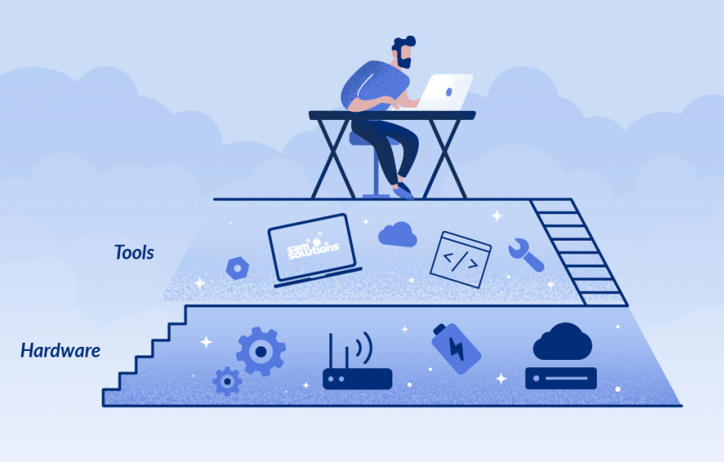
Lab 08 - Platform as a Service
https://bit.ly/3IjEuD7

